Slide 1
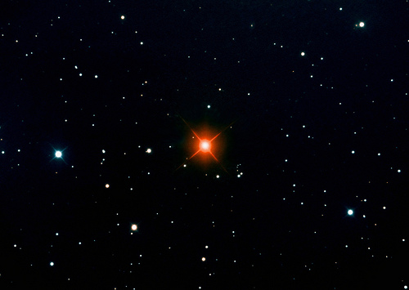
Hind’s Crimson Star
R Leporis

Slide 2
Hind’s Crimson
Star
R Leporis
This is a red variable carbon-star giant in the constellation Lepus (the hare).
It has a variability period of 427.07 days, and may have a long secondary variability of 40 years.

Slide 3
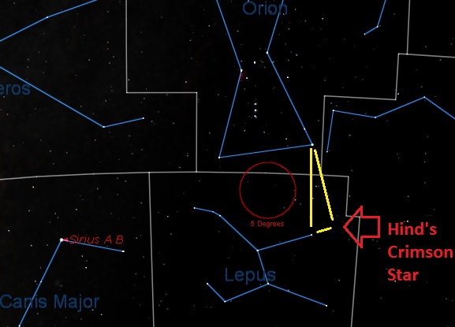
Hind’s Crimson Star
R Leporis

Slide 4
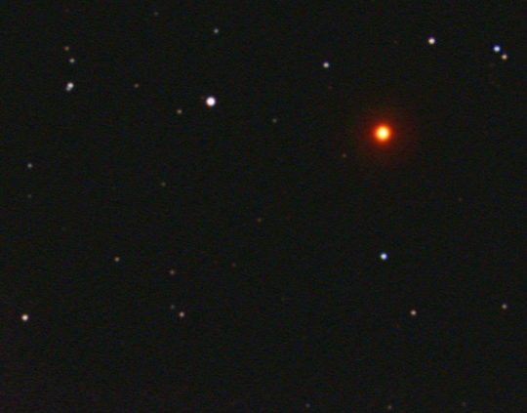

Hind’s Crimson Star
Temperature: 3600⁰ F
B-V Color Index: +5.70, red
Size: 480 – 535x the diameter Sun (if it were our Sun, it would extend past the asteroid belt)

Slide 5
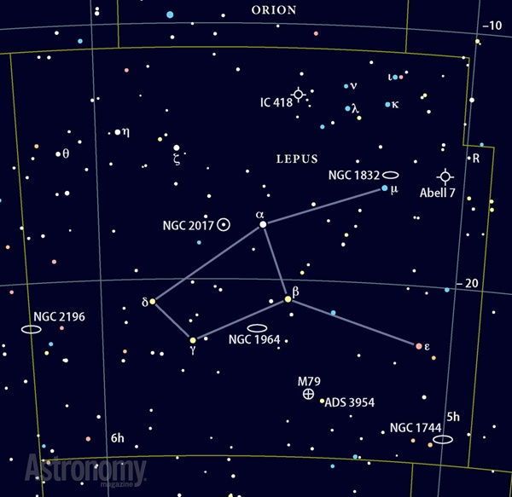
Hind’s Crimson Star
Lepus Constellation

Slide 6
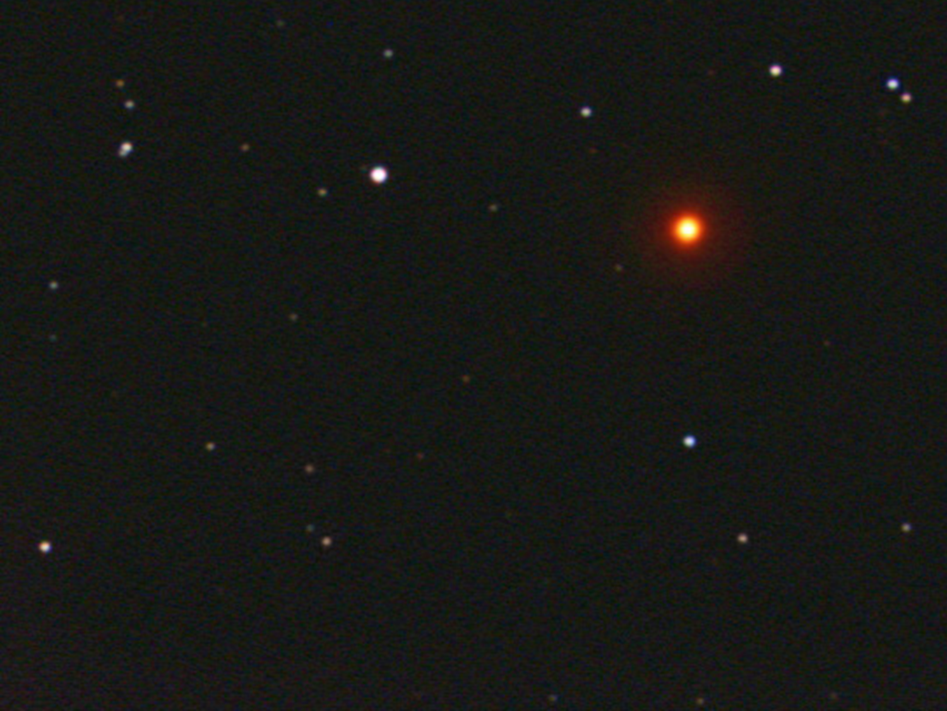
Hind’s Crimson Star
Luminosity: 85.6 Suns visual (between
  5,200 and 7,000 x the Sun in infrared)
Mass: Unknown, but likely 2.5 – 5.0 solar masses
Magnitude Range: +5.50 to +11.70

Slide 7
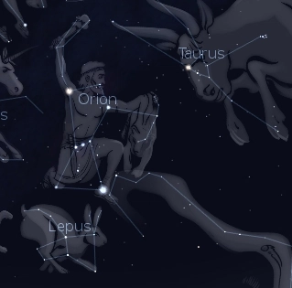
Hind’s Crimson Star

Slide 8
Hind’s Crimson Star
1,300 light years away
Light we’re seeing left in the 700s:
    • Chinese invented gunpowder.
    • Charlemagne ruled France.
    • Muslims conquered Spain.

Slide 9
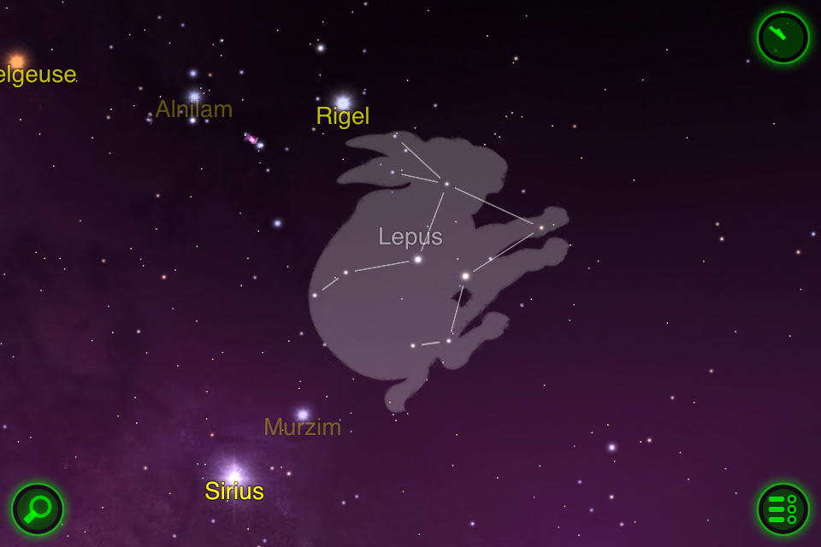
Hind’s Crimson Star

Slide 10

Carbon Star Basics
As sun-like stars age, their core compresses and heats up and basically cooks the helium nuclei into carbon. The convective currents in the star’s atmosphere move the carbon from the core to the outer layers where they form a fine soot. The soot scatters away blue and green light, so only the red and orange wavelengths penetrate the carbon dust to reach our eyes.

Slide 11
Carbon Star Basics
• Sunsets are red for similar reasons to carbon stars. At the horizon, sunlight travels through more atmosphere, scattering away the blues and greens, leaving the red for our eyes.
• All carbon stars are variable and vary in brightness over the course of months or even more than a year.

Slide 12


Slide 13


Carbon Star Basics

Slide 14

Carbon Star Basics
Carbon stars vary in color. What color do you see in the telescope?

